Slide 1
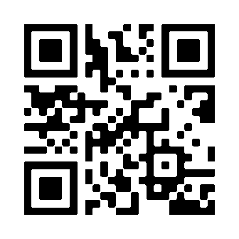
An innovative approach towards youth inclusion:
the ALMA initiative getting off the ground
Moderator: Fabienne Lévy (Head of Unit – European Commission – FR)
Speakers: Wayne Dimech (Representative – Jobsplus – MT)
Judit Garriga (Project Manager – Associació Alba – ES)
Andreea Moraru (Programme manager – RE/init e.V. – DE)
ALMA Website

